Slide 1
Title : Foundation Models : Transforming Autonomous Driving
Subtitle: Insights from Gao et al. (2024) Survey on Revolutionizing AD with AI
Visuals: A futuristic image of a self-driving car (e.g., stock photo of a sleek autonomous vehicle or a Waymo/Tesla prototype).
Based on: A Survey for Foundation Models in Autonomous Driving (arXiv:2402.01105)
Presented by: Manjunatha Inti

Slide 2
The Quest for Autonomous Driving
Content:
Autonomous Driving (AD): Replicating human driving with safety and efficiency.
Traditional AD systems: Modular (perception, prediction, planning, control).
Challenges: Scalability, adaptability to novel scenarios, integration complexities.
Enter Foundation Models: Large-scale AI trained on diverse datasets (text, images, sensors).

Slide 3
From Modular to Unified Models
Content:
Modular Systems: Specialized but fragmented, requiring extensive tuning.
Foundation Models: Unified framework for perception, prediction, planning.
Benefits: Enhanced coherence, adaptability, reduced development time.
Examples: Waymo’s EMMA (Gemini-based), Tesla’s transformer model

Slide 4
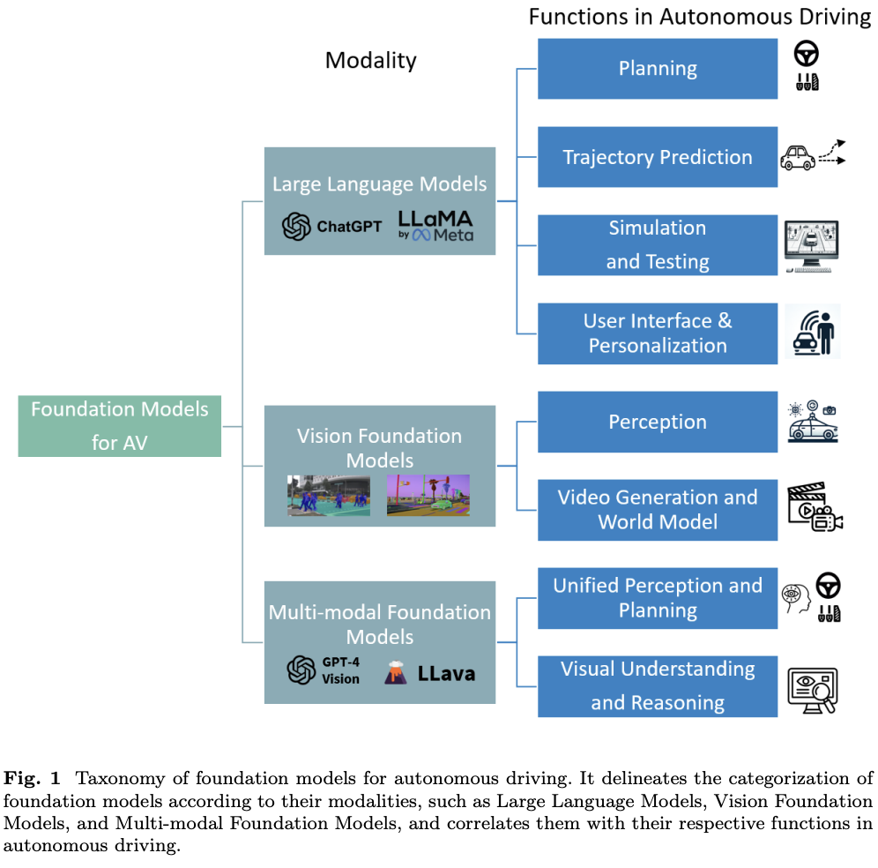
A Taxonomy of AD Foundation Models
Three Modality Branches:
LLMs: Text-based reasoning, planning, simulation.
VFMs: Visual perception, video synthesis.
MFMs: Multi-modal end-to-end driving, Q&A.
Functional Layers: Perception, prediction, planning, explainability.

Slide 5
Large Language Models (LLMs)
Applications:
Reasoning & Planning: GPT-Driver (0.44% collision rate, LoRA fine-tuning).
Trajectory Prediction: BERT + visual data (7% minADE drop on nuScenes).
User Interaction: “Drive cautiously” → personalized behavior.
Simulation: ADEPT generates crash scenarios.
Challenges: Hallucination, latency (~2.8s inference).

Slide 6
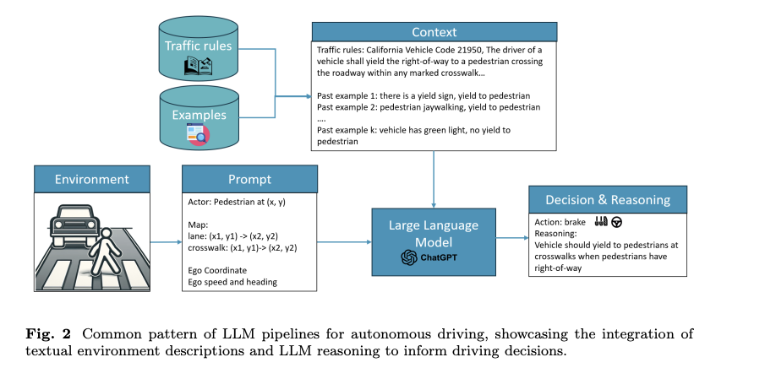

Slide 7
VFMs: Eyes on the Road
Content:
Perception: SAM3D (46.8 AP on Waymo, struggles with sparse lidar).
Simulation: GAIA-1, DriveDreamer (photorealistic video generation).
Strengths: Generalization across environments.
Weaknesses: Sparse data handling, massive dataset needs.

Slide 8
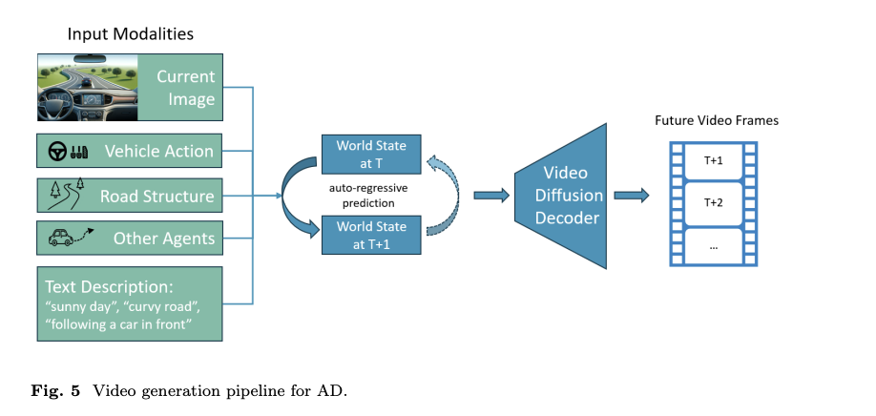

Slide 9
MFMs: Blending Sight and Insight
Content:
Visual Reasoning: HiLM-D (4.8% BLEU-4 boost), Talk2BEV (15Hz spatial Q&A).
End-to-End Driving: DriveGPT4 (handles long-tail scenarios).
Explainability: Structured action explanations (e.g., “turning left due to obstacle”).
Hurdles: Hallucination, 3D data limitations.

Slide 10
Challenges and Limitations
Content:
Hallucination: False outputs (0.44% collision rate in GPT-Driver).
Latency: ~2.8s inference, 110GB VRAM for LLMs.
Data Dependency: AD datasets (<1,000 hours) vs. web-scale corpora.
Sim-to-Real Gap: Simulations miss real-world complexities.
Responsible Release: Risks of adversarial spoofing.

Slide 11
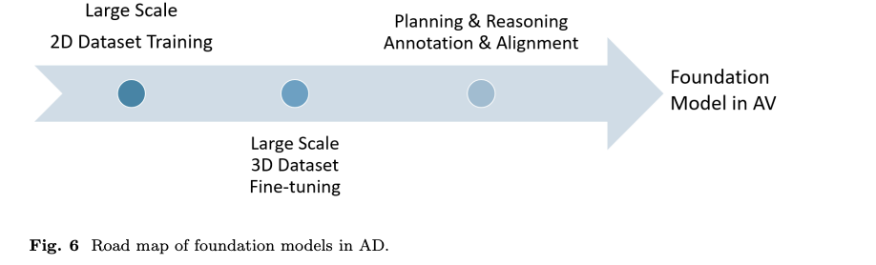
Future Research Directions
Key directions:
Domain-specific model training/fine-tuning.
Enhancing 3D sensor data integration.
Reducing hallucinations through human-in-the-loop approaches.
Improving model efficiency (compression, optimization).

Slide 12
Conclusions & Closing Thoughts
Foundation models significantly advance AD, offering adaptability, scalability, and improved user interaction.
Addressing current limitations is crucial for safe real-world deployment.
Collaboration across disciplines (AI researchers, automotive engineers, policymakers) is essential.
Goal: Safer, more accessible transportation for everyone.

Slide 13
References
Gao, H., Wang, Z., Li, Y., Long, K., Yang, M., & Shen, Y. (2024). A Survey for Foundation Models in Autonomous Driving. arXiv preprint arXiv:2402.01105.

